Slide 1

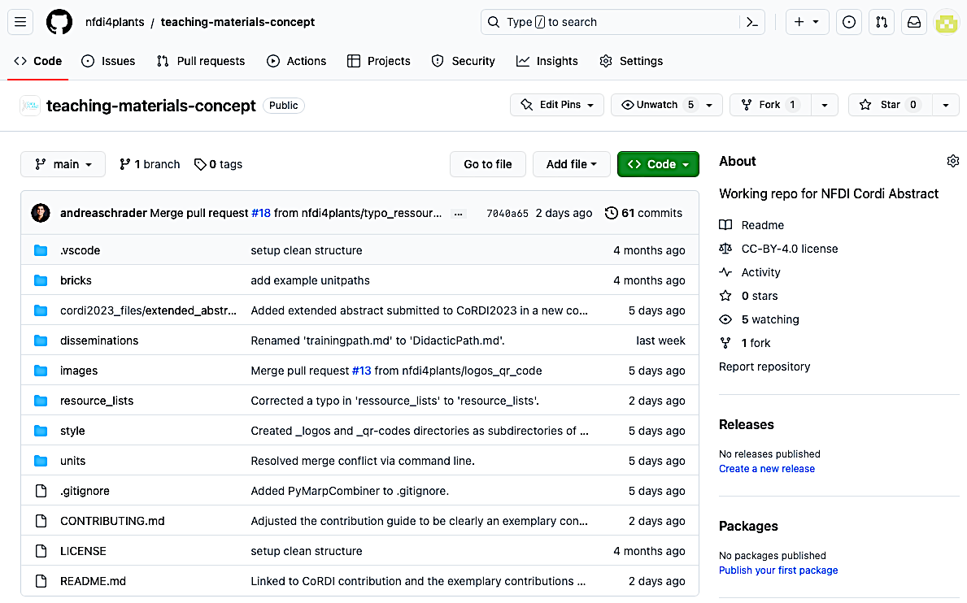

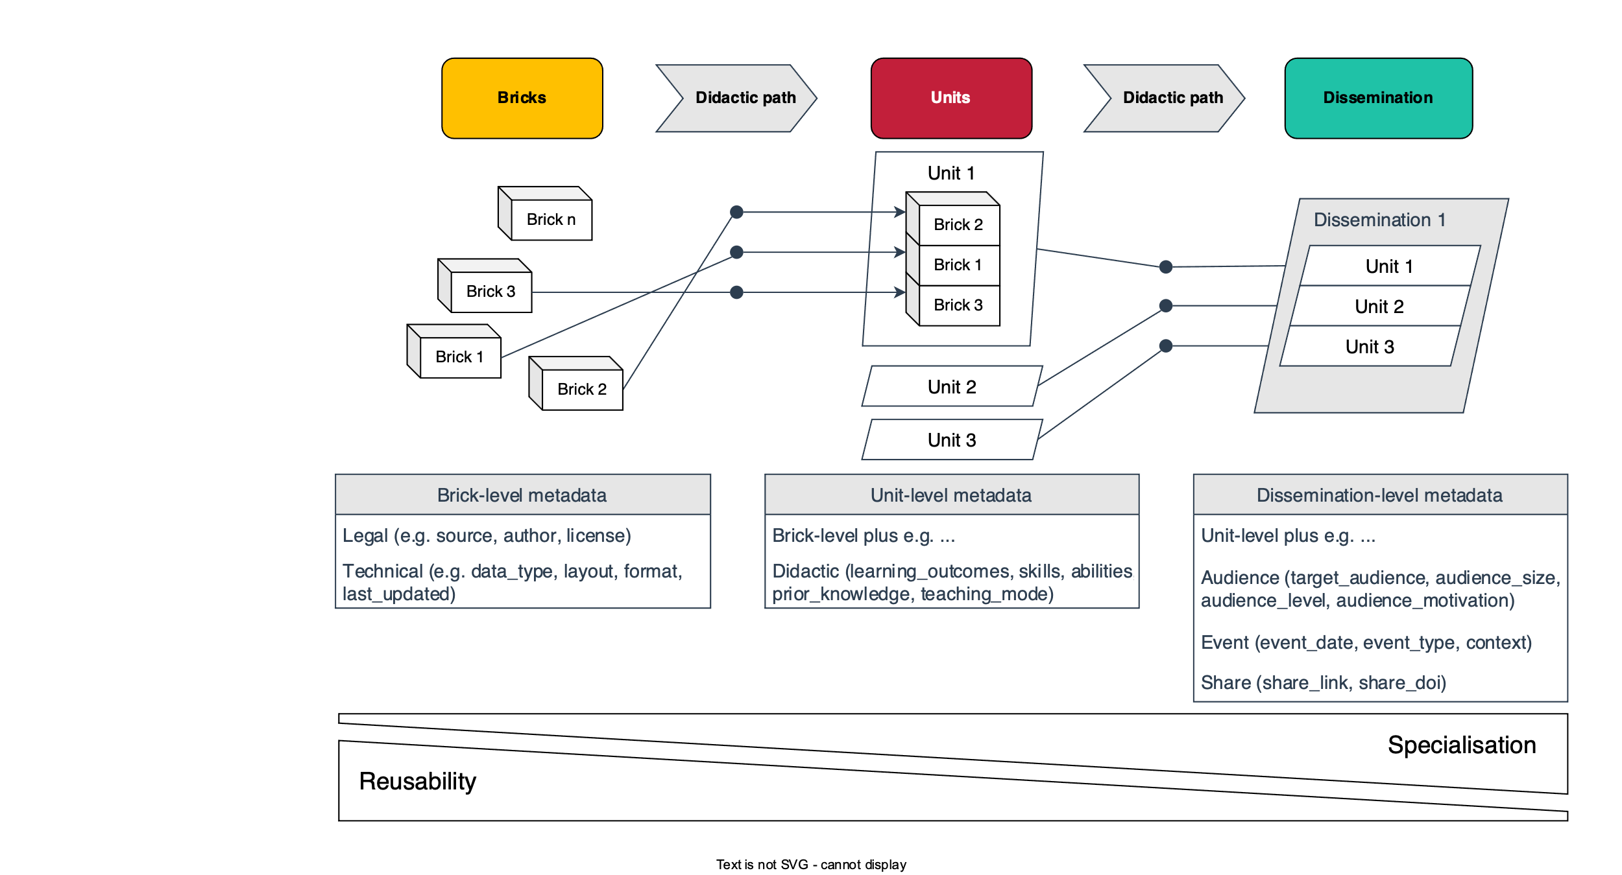




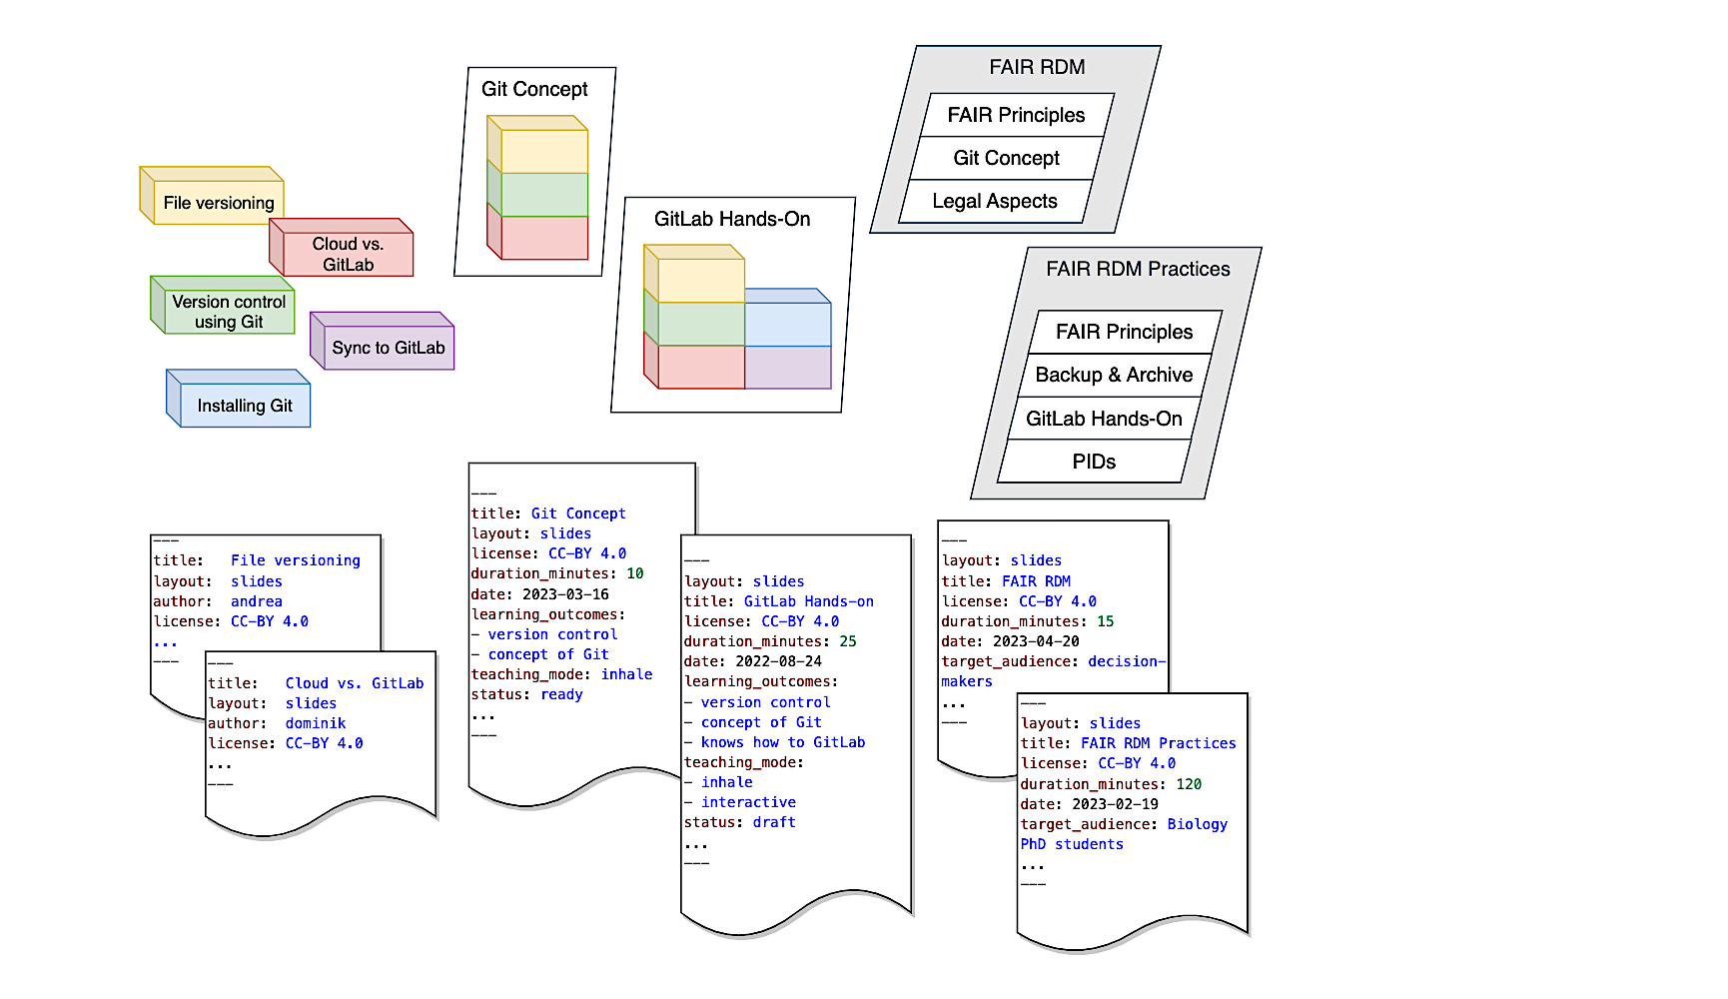
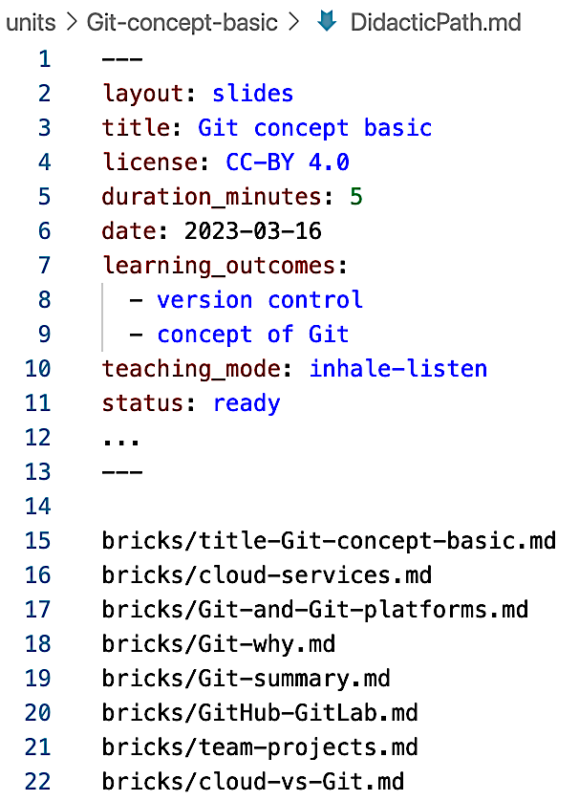
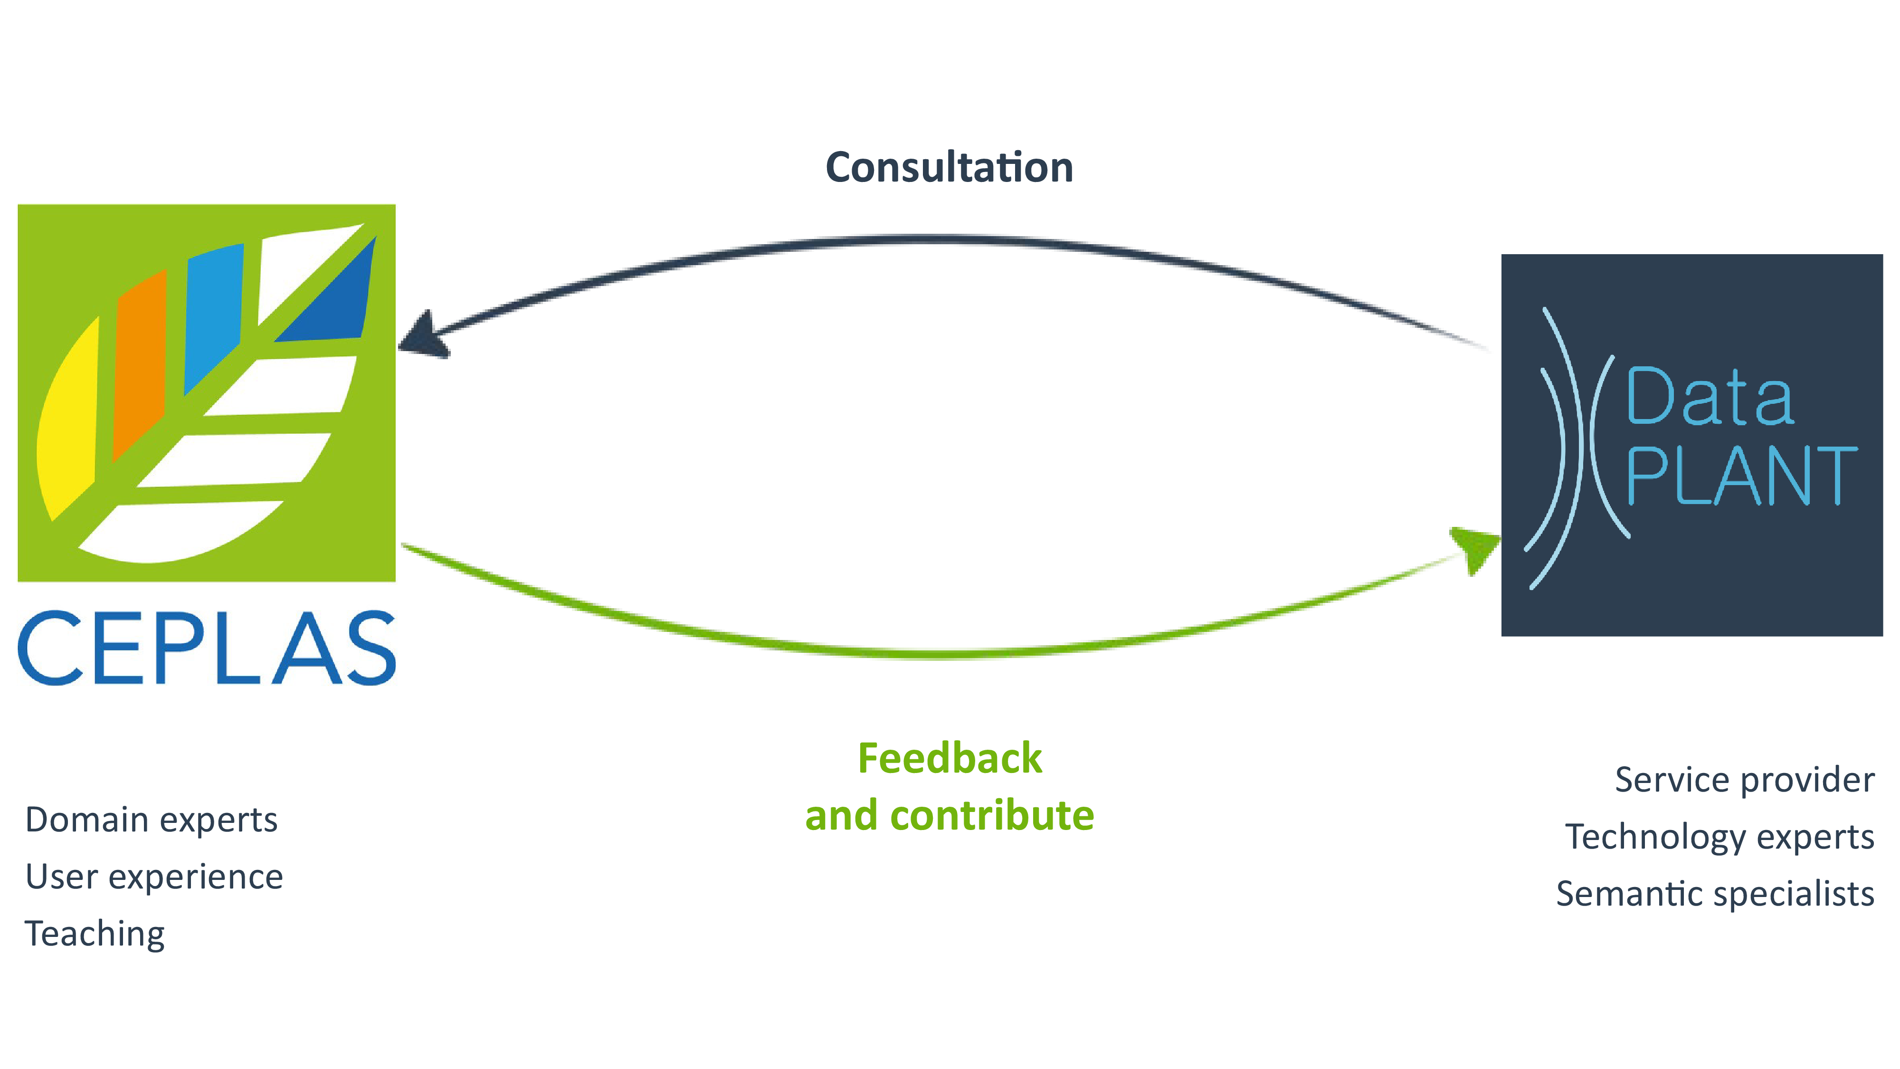



One Resource to Teach Them All
Dominik Brilhaus¹, Martin Kuhl², Cristina Martins Rodrigues³, Andrea Schrader⁴ (in alphabetical order)
1: Data Science and Management, CEPLAS, Heinrich Heine University Düsseldorf, Germany, 2: Computational Systems Biology, DataPLANT, University of Kaiserslautern-Landau, Germany, 3: eScience, DataPLANT,
University of Freiburg, Germany, 4: Data Science and Management, CEPLAS, University of Cologne, Germany
Motivation
Teaching materials are often scattered, hard to find, and fragmented.
We follow the principles of Open Educational Resources (OER) promoting easy access to educational materials and increased chances of educational equity^{[1]}. A central collection of materials allows the respective community to add and improve contributions with transparent and traceable authorship and licensing of contents.
We aim at one adaptable OER for all: a light-weighed, central, reusable, open and contribution-open resource of materials for varying learning environments. Therefore, we develop a teaching material resource based on the concept of annotated bricks along didactic paths for DataPLANT.
Screenshot of the DataPLANT teaching-materials-concept GitHub repository. Implemented and further developed in the DataPLANT Knowledge Base:
https://nfdi4plants.org/nfdi4plants.knowledgebase/
3 Levels Balance Customisation & Reuse
Individual slides/text/paragraph
Smallest possible educational content snippet
Coherent building blocks - slide decks
Cover a complete idea, thought or topic
Combined building blocks
Composed along a didactic path adapted to a learning environment, target group or person
Bricks
Units
Disseminations
Modular concept for the DataPLANT OER.
Metadata: From Bricks to Disseminations
Inspired by previous recommendations^{[2,3]}
Aggregated YAML front matter
In markdown files along didactic path upon compilation.
Didactic Path
Ordered list of paths to bricks, units, disseminations
May contain metadata in a levelled YAML header
Suggested Tools
Design: VS Code + Marp extension
Collaborate: Git + GitLab/GitHUB
Compile / Convert: (Py)MarpCombiner + Marp CLI
Didactic path
Left: Didactic path example with paths relative to the root of the repository. Another option: paths relative to the output location. Right: Example “version control using Git” to elaborate our levelled concept.
Visit the
Concept Repository
Collaborations:
References:
1: UNESCO (2022) UNESDOC Digital Library, Catalog Number 0000383205, accessed: Apr. 21, 2023.
2: Garcia, L et al. (2020) PLoS Comput Biol, vol. 16, no. 5, e1007854
3: Batut, B et al. - PURL: https://gxy.io/GTN:T00062, accessed: Apr. 21, 2023
We acknowledge the support of DataPLANT, funded by the German Research Foundation (DFG) within the framework of the NFDI – project number: 442077441 &
CEPLAS, funded by the Deutsche Forschungsgemeinschaft (DFG, German Research Foundation) within Germany´s Excellence Strategy – EXC-2048/1 – project ID 390686111.

